Slide 1
Summary of catabolism

Slide 2
Major Catabolic Pathways
Glycolysis*****
Citric acid cycle *****
β-oxidation
Urea cycle
Oxidative phosphorylation
Photophosphorylation

Slide 3
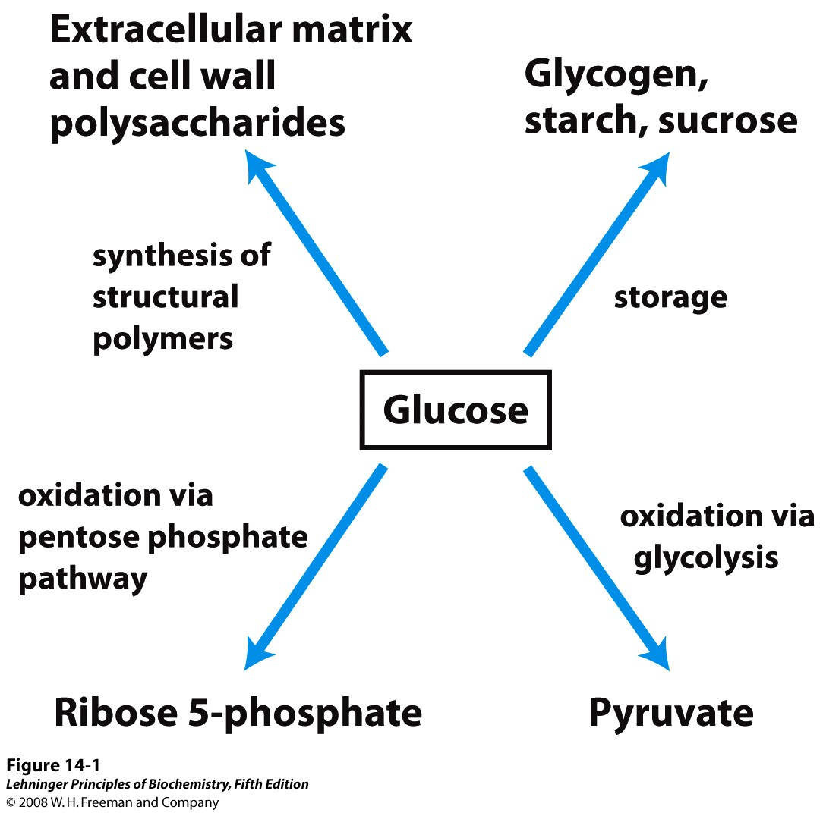
Major pathways of glucose utilization

Slide 4
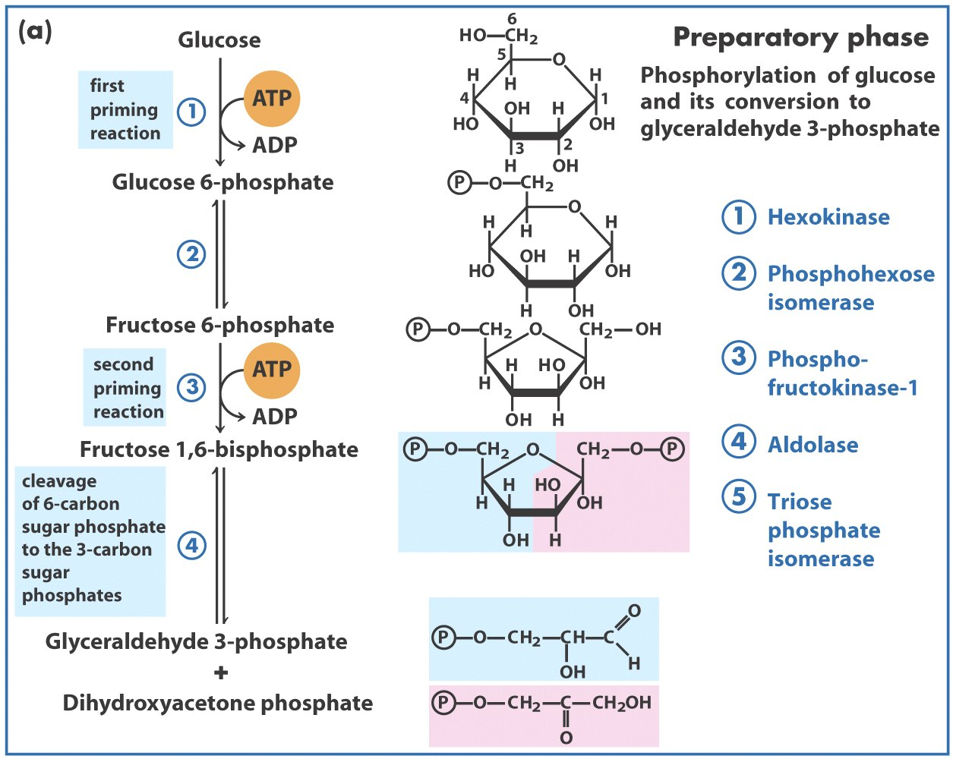
Group
transfer
Isomerization
Group
transfer
Aldol cleavage
Two molecules
of ATP are
consumed
Isomerization

Slide 5
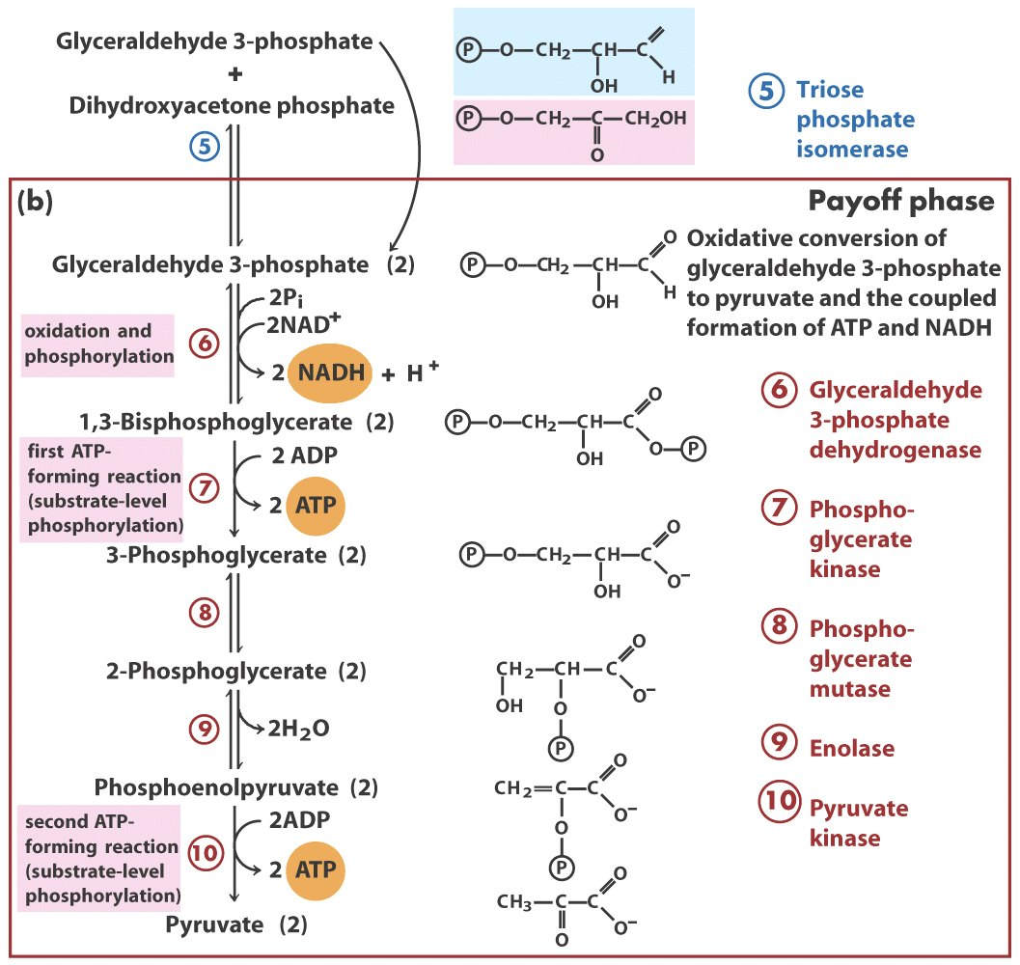
Isomerization
Dehydrogenation
Group transfer
Group shift
Dehydration
Group transfer
Four molecules of ATP and
two molecules of NADH
are generated

Slide 6
Regulation of glycolysis
Regulatory enzymes of glycolysis:
Hexokinase
Phosphofructokinase-1 (PFK-1)*****
Pyruvate kinase
They all catalyze exergonic and
irreversible reactions, and are
all regulated by allosteric effectors.

Slide 7
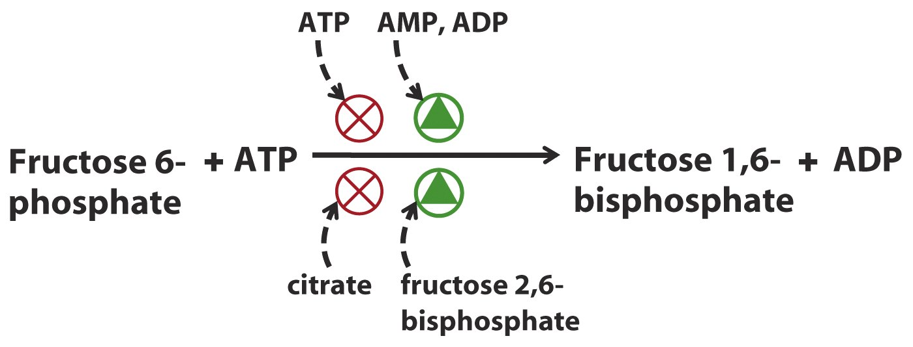
Regulators that affect PFK-1 activity
*****

Slide 8
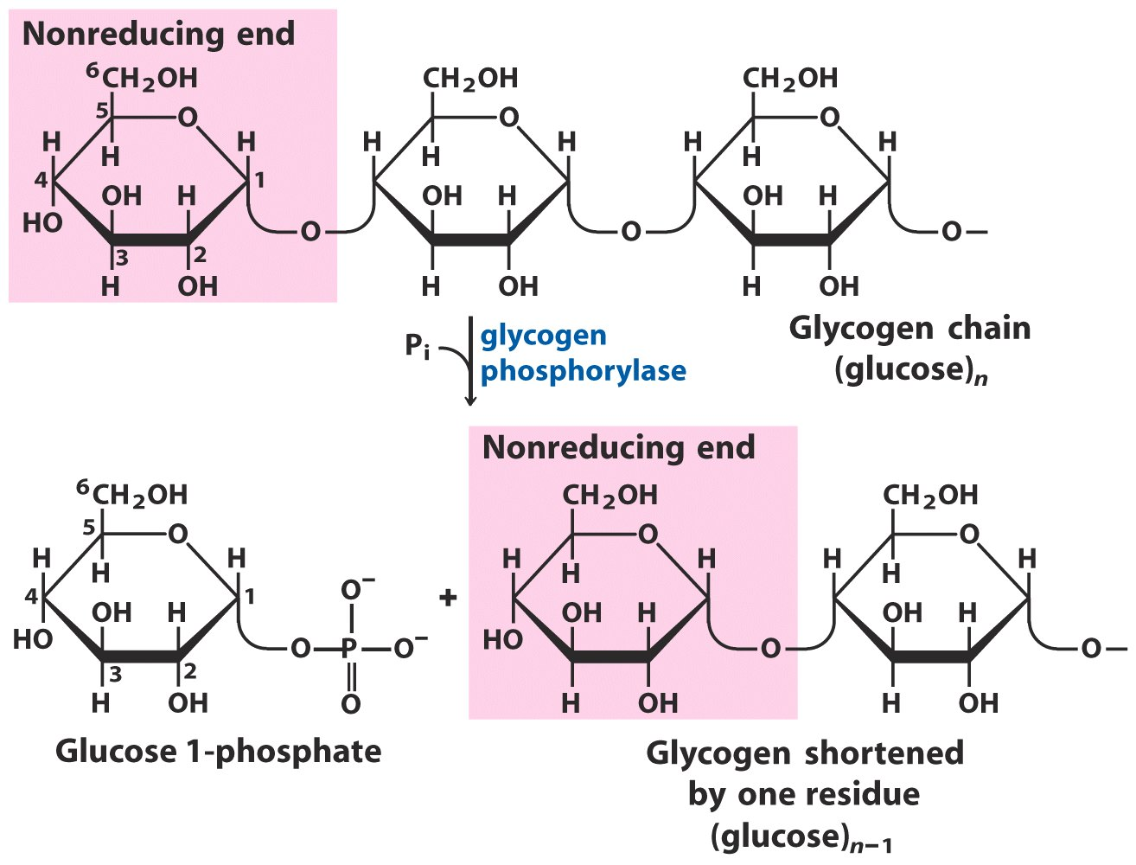
No ATP needed!
Glycogen breakdown by glycogen phosphorylase

Slide 9
Regulation of glycogen phosphorylase
Covalent regulation by phosphorylation:
The activity of glycogen phosphorylase kinase is regulated by hormones.
Allosteric regulation:
Different in muscle and in liver

Slide 10
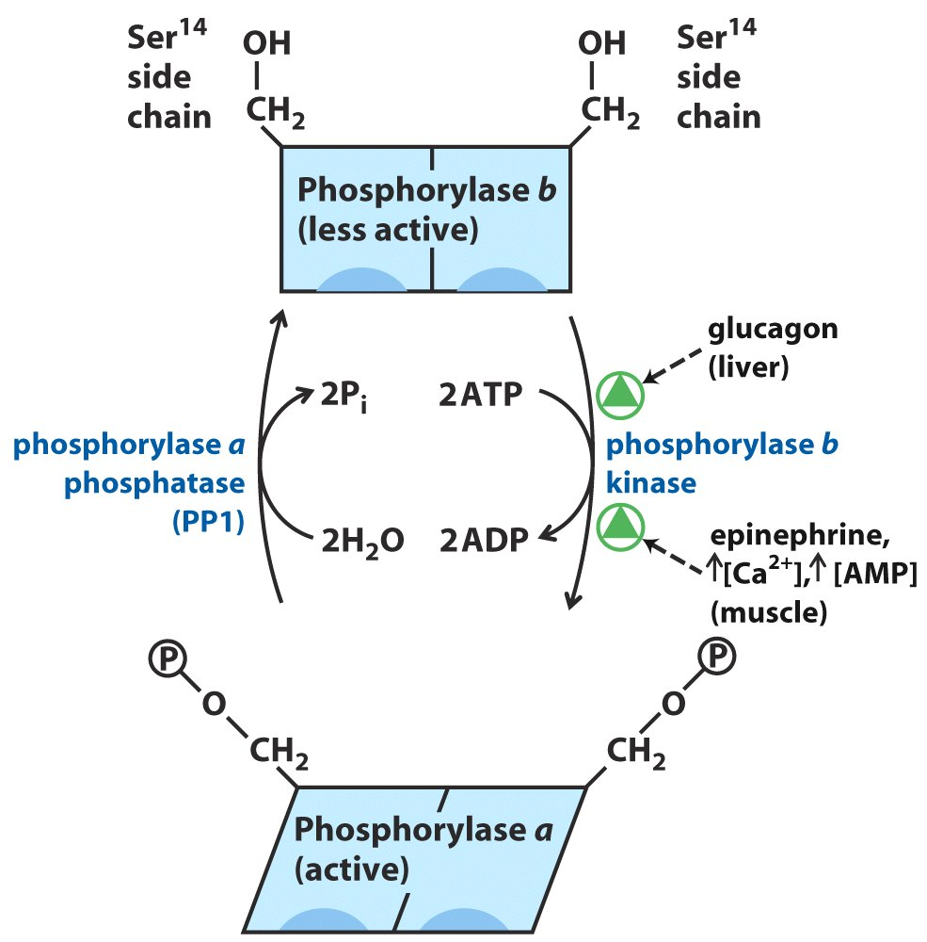
Regulation of muscle glycogen phosphorylase

Slide 11
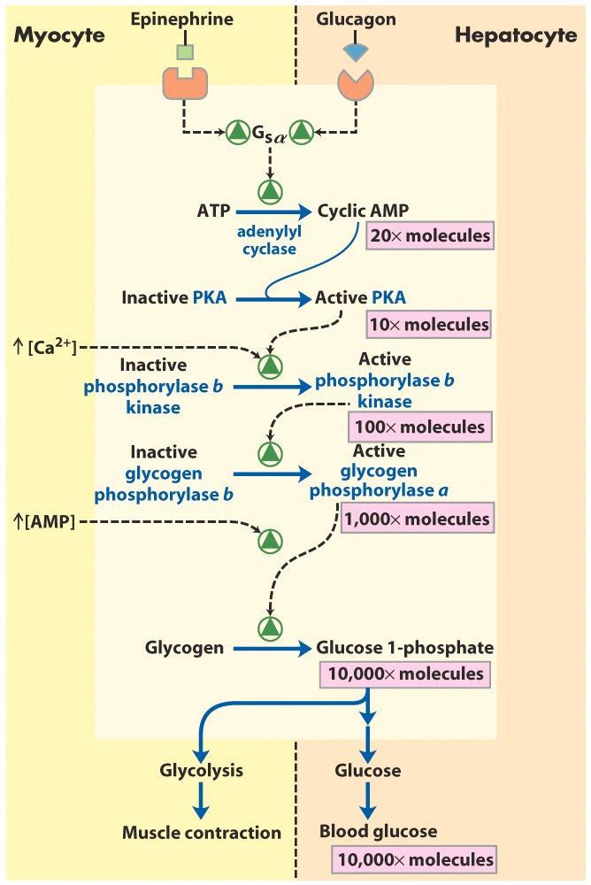
Cascade mechanism of
epinephrine and
glucagon action

Slide 12
Glycogen phosphorylase is also regulated allosterically, but differently in muscle and liver
In muscle:
AMP or Ca²⁺ activates the b form of the enzyme.
ATP inactivates the enzyme.
In liver:
Glucose binds to the a form of enzyme, exposing the phosphorylated Ser residues to the action of phosphorylase a phosphatase and converting it to the less active b form.

Slide 13
The liver glycogen phosphorylase a is
negatively regulated by glucose, therefore,
can function as a glucose sensor

Slide 14
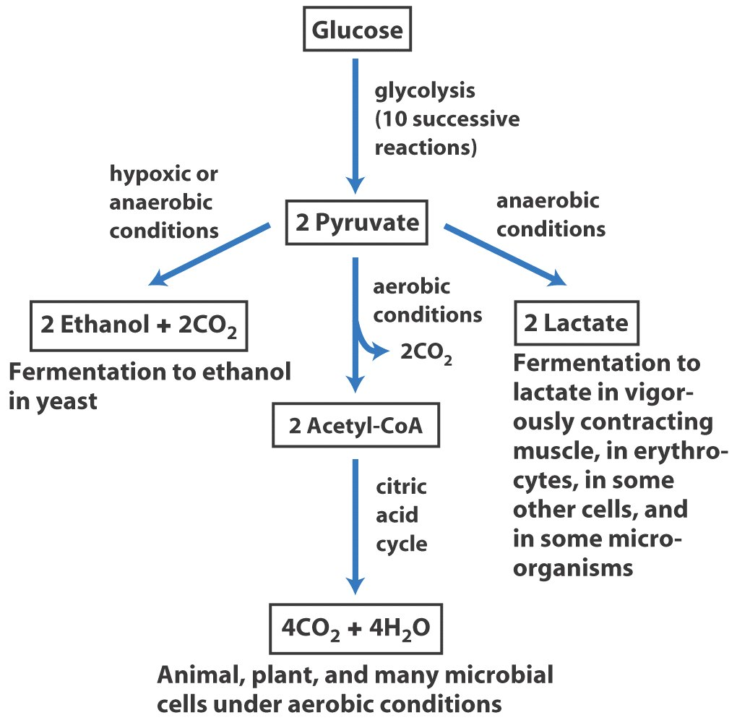
Fates of pyruvate
Serve as a precursor
in anabolic reactions

Slide 15
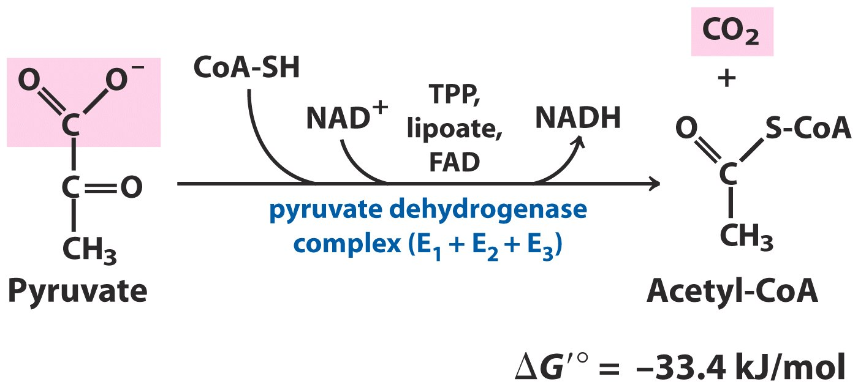
Production of acetyl-CoA
Oxidative decarboxylation

Slide 16
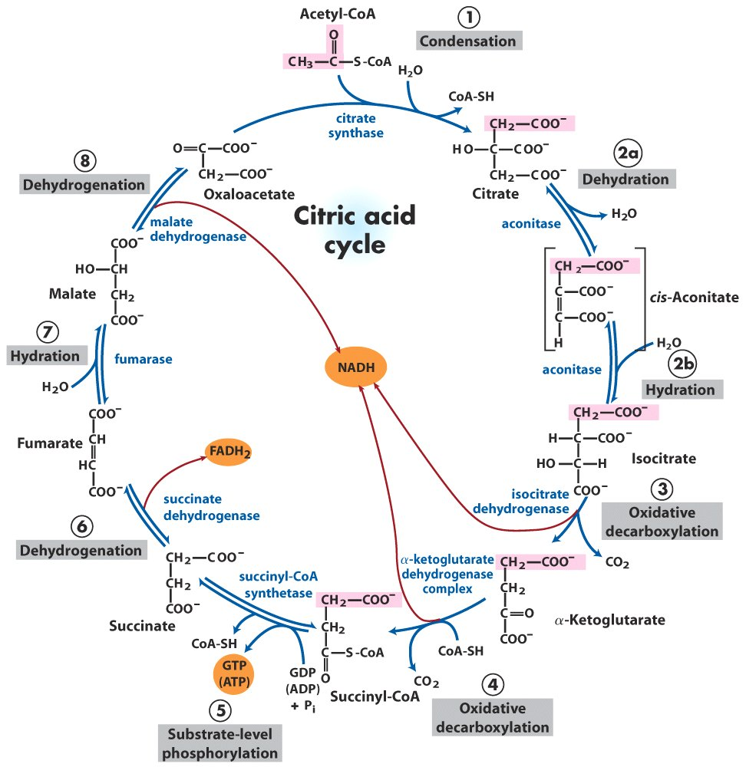
Reactions of the citric acid cycle

Slide 17
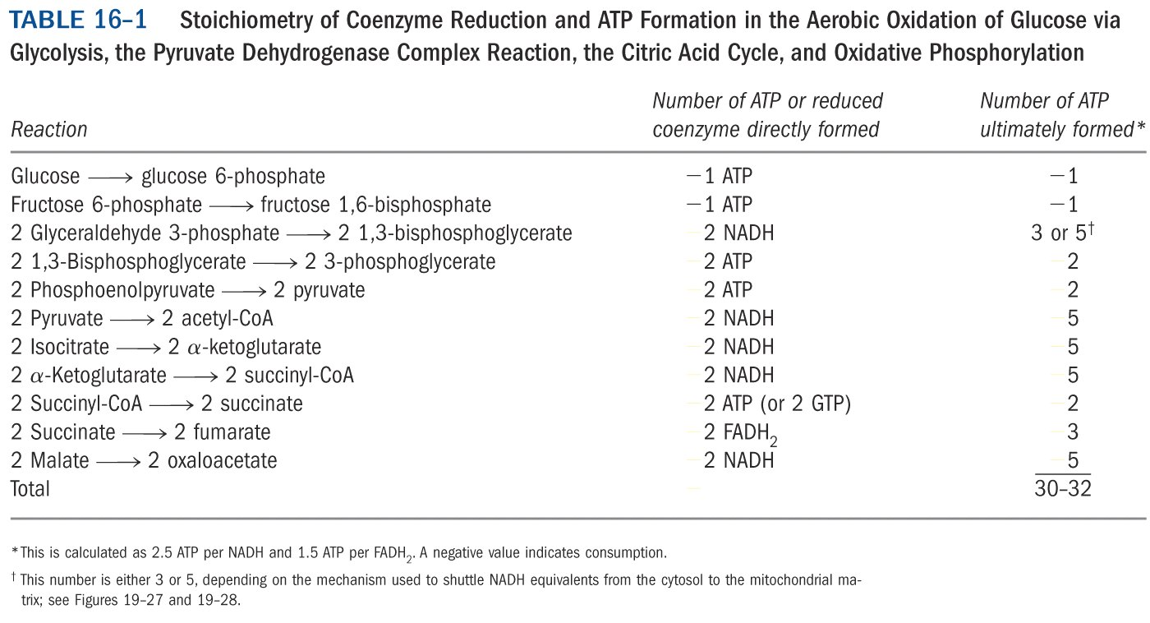
*****

Slide 18
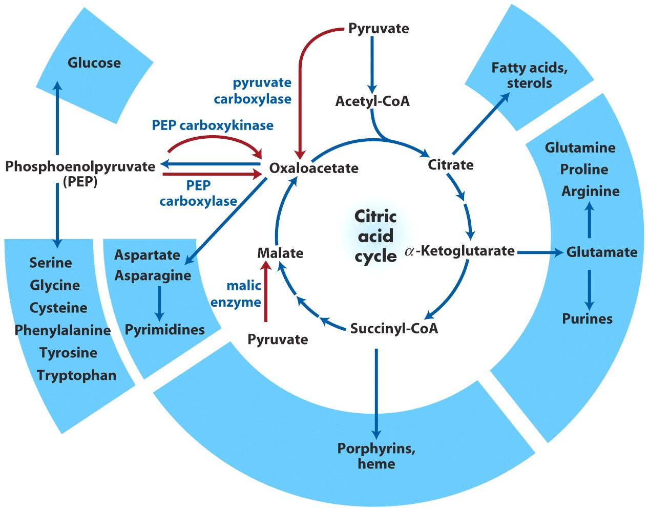
Citric acid cycle provides precursors for many biosynthetic pathways

Slide 19
Regulation of the citric acid cycle
Regulatory enzymes:
Pyruvate dehydrogenase complex
Citrate synthase
Isocitrate dehydrogenase
α-ketoglutarate dehydrogenase

Slide 20
The pyruvate dehydrogenase complex in vertebrates is regulated allosterically and covalently
The formation of acetyl-CoA from pyruvate is a key irreversible step in animals because they are unable to convert acetyl-CoA to glucose.
The complex (in all organisms) is allosterically inhibited by signaling molecules indicating a rich source of energy, e.g., ATP, acetyl-CoA, NADH, long chain fatty acids; activated by molecules indicating a lack (or demand) of energy, e.g., AMP, CoA, NAD⁺, Ca²⁺.

Slide 21
The activity of the complex (in vertebrates, probably also in plants, but not in E. coli) is also regulated by reversible phosphorylation of one of the enzymes, E₁, in the complex: phosphorylation of a specific Ser residue inhibits and dephosphorylation activates the complex.
The kinase and phosphatase is also part of the enzyme complex.
E₁ (unphosphorylated)---active
E₁ (phosphorylated)---inactive
Kinase involved is activated by ATP, but inhibited by a drug called dichloroacetate.

Slide 22
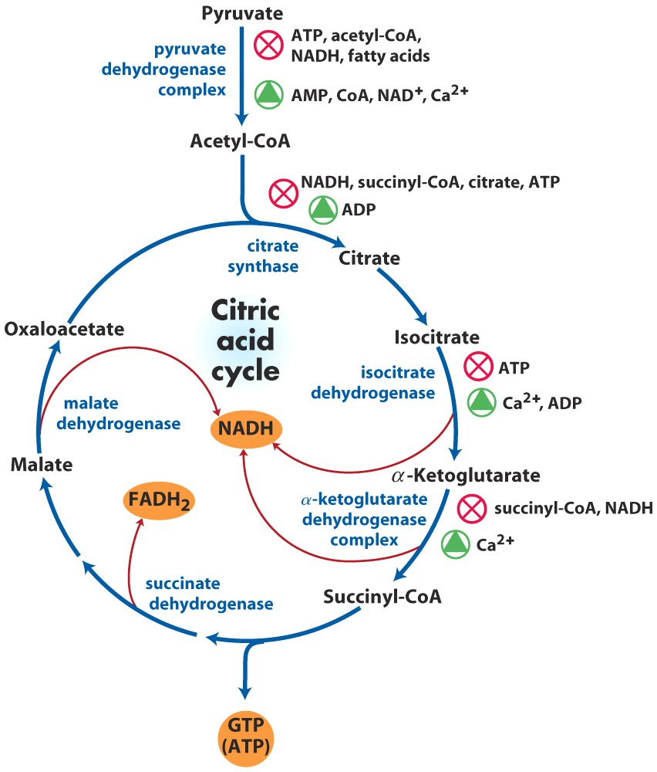
Regulation of the citric acid cycle

Slide 23
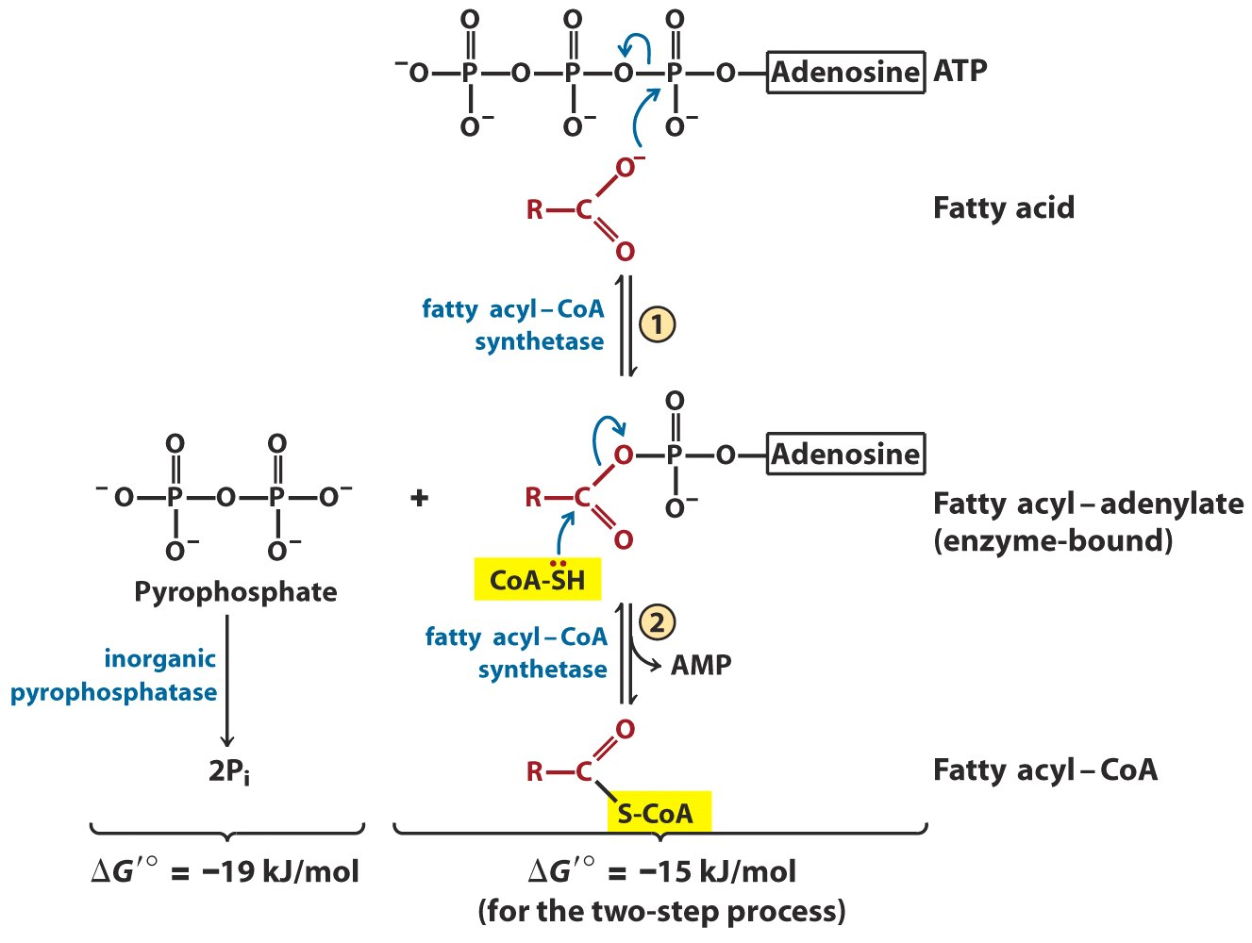
Conversion of a fatty acid to a fatty acyl-CoA

Slide 24
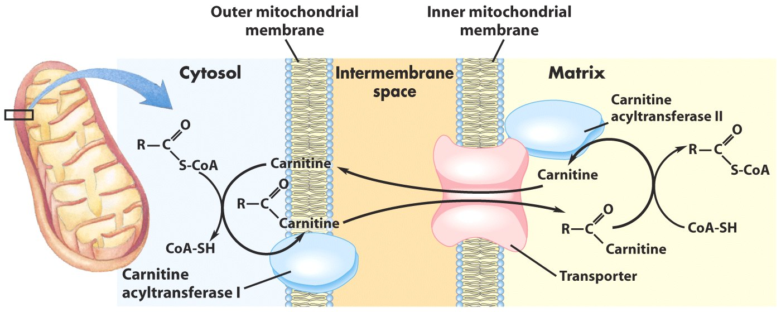
Fatty acid entry into mitochondria
via the acyl-carnitine/carnitine transporter

Slide 25
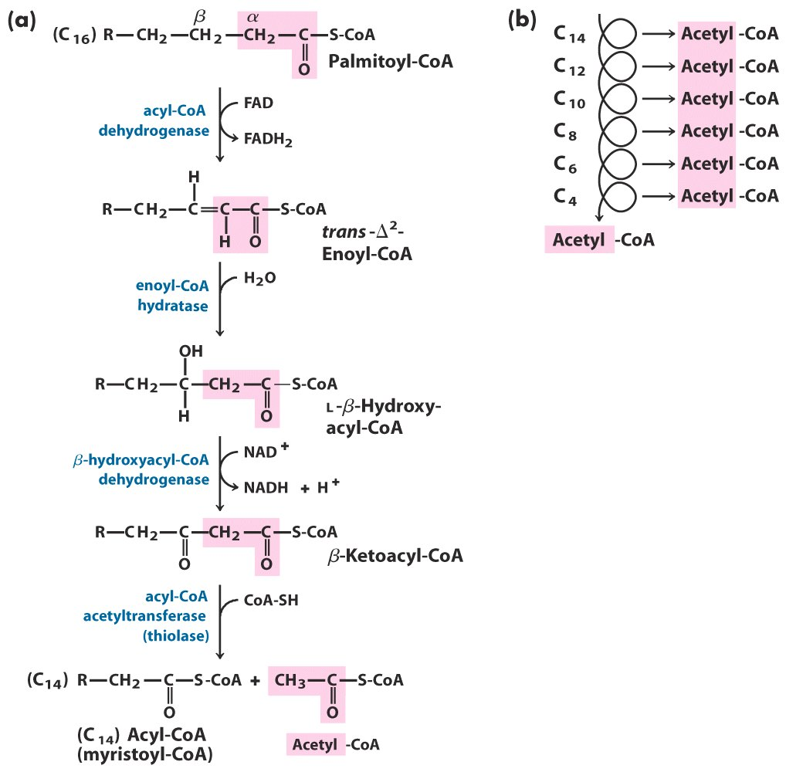
The β-oxidation pathway

Slide 26
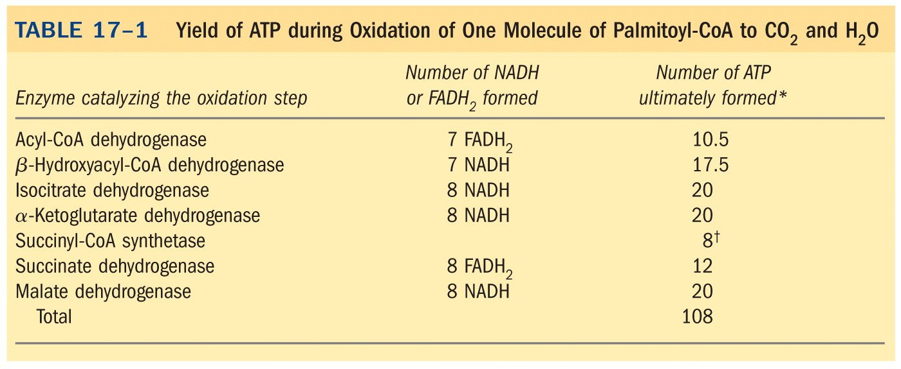
*****
Palmitoyl-CoA+23O₂+108P_{i}+108ADP
CoA+108ATP+16CO₂+23H₂O

Slide 27
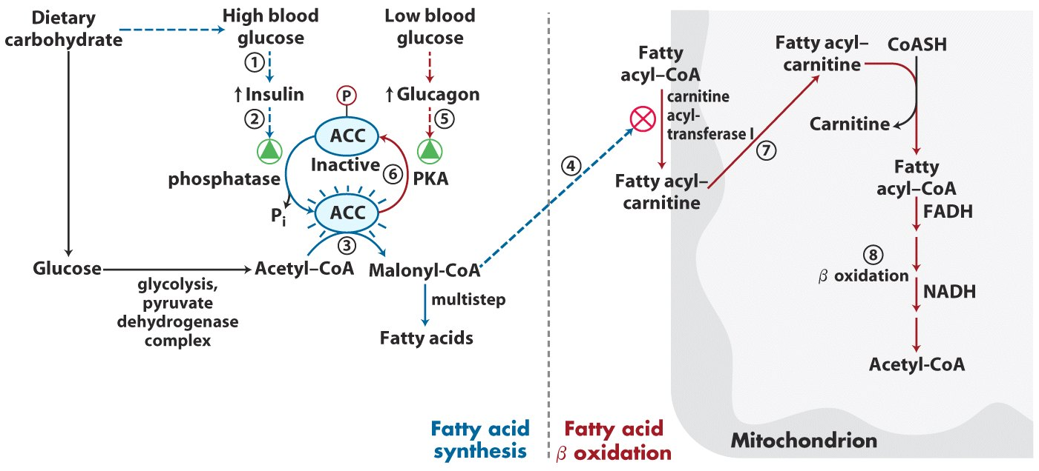
Coordinated regulation of fatty acid synthesis and breakdown

Slide 28
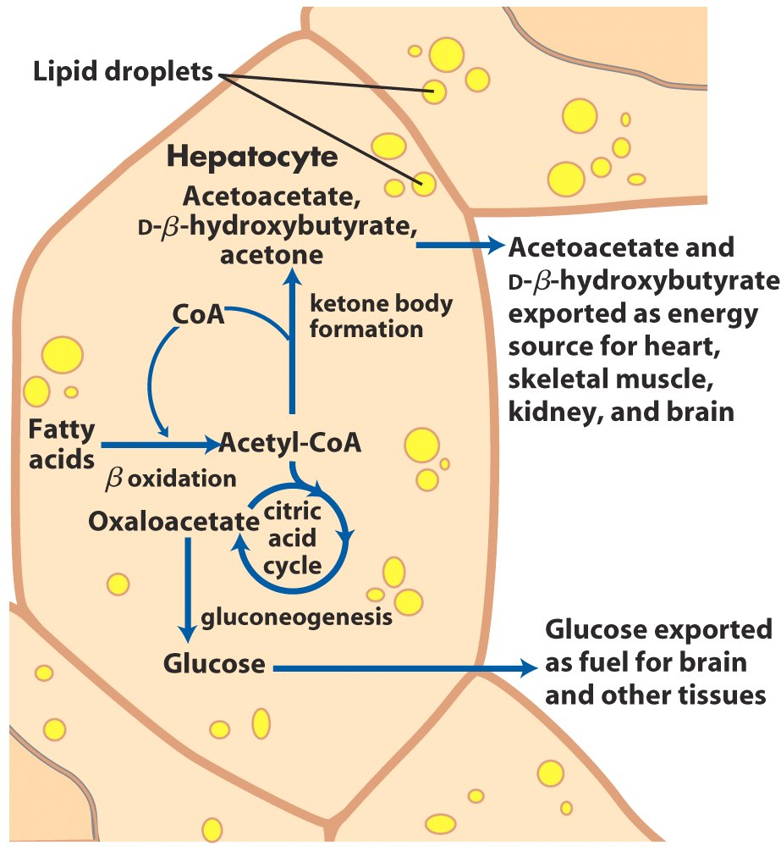
Ketone body formation and export from the liver

Slide 29
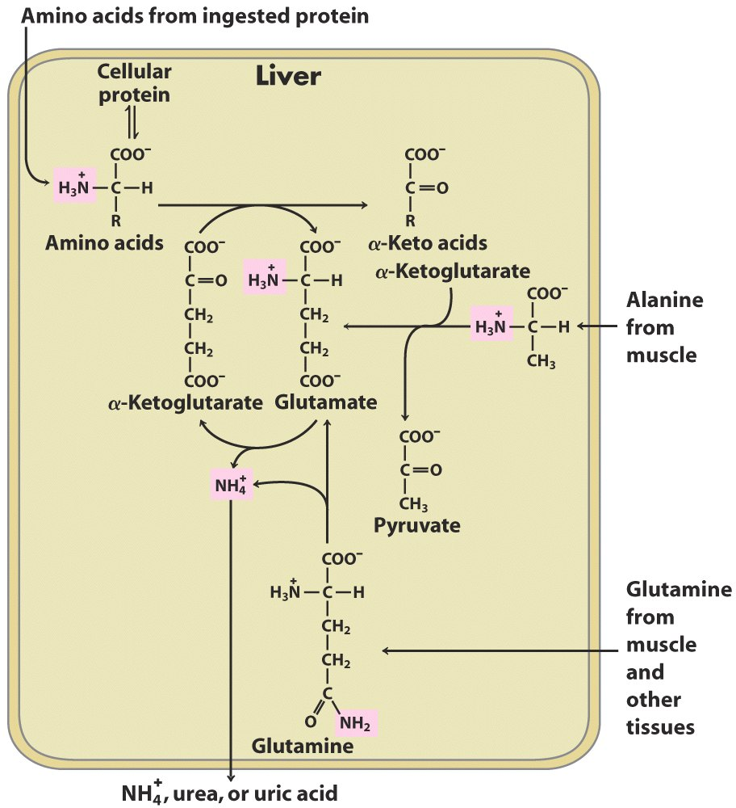
Overview of catabolism of amino groups in vertebrate liver

Slide 30
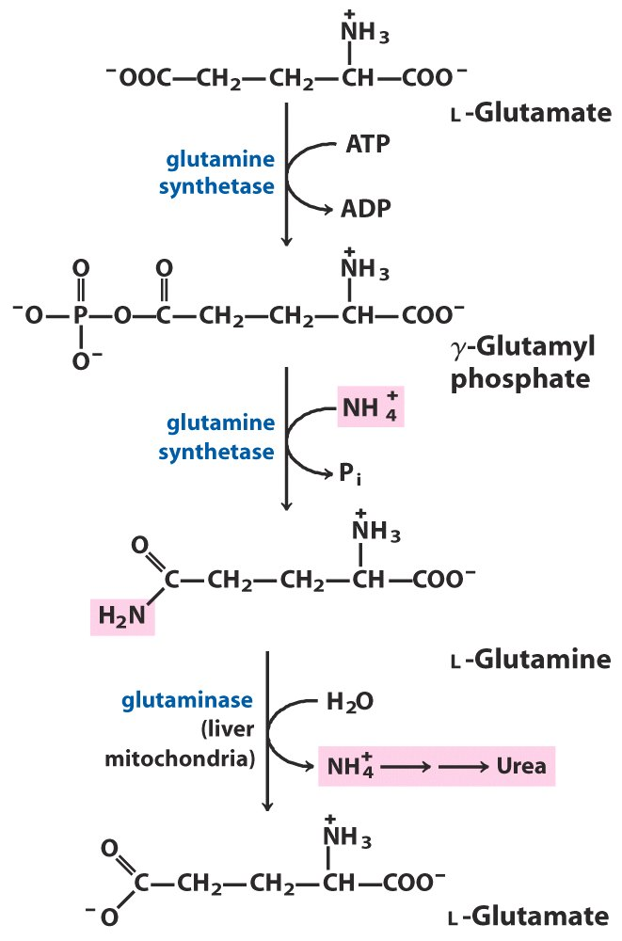
Ammonia transport in the form of glutamine

Slide 31
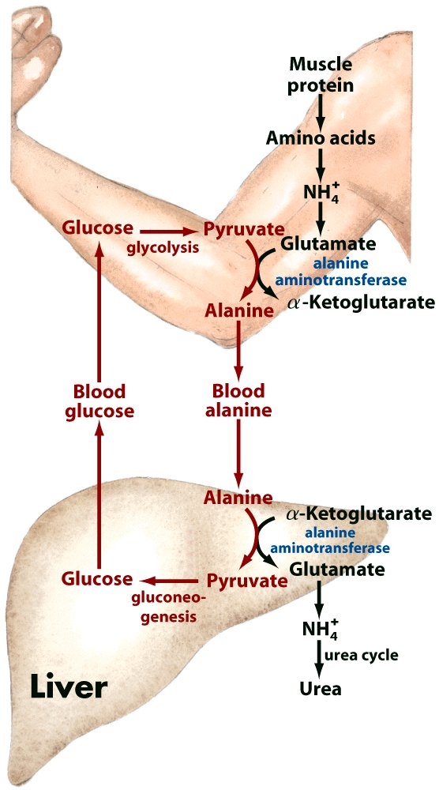
Glucose-alanine cycle

Slide 32
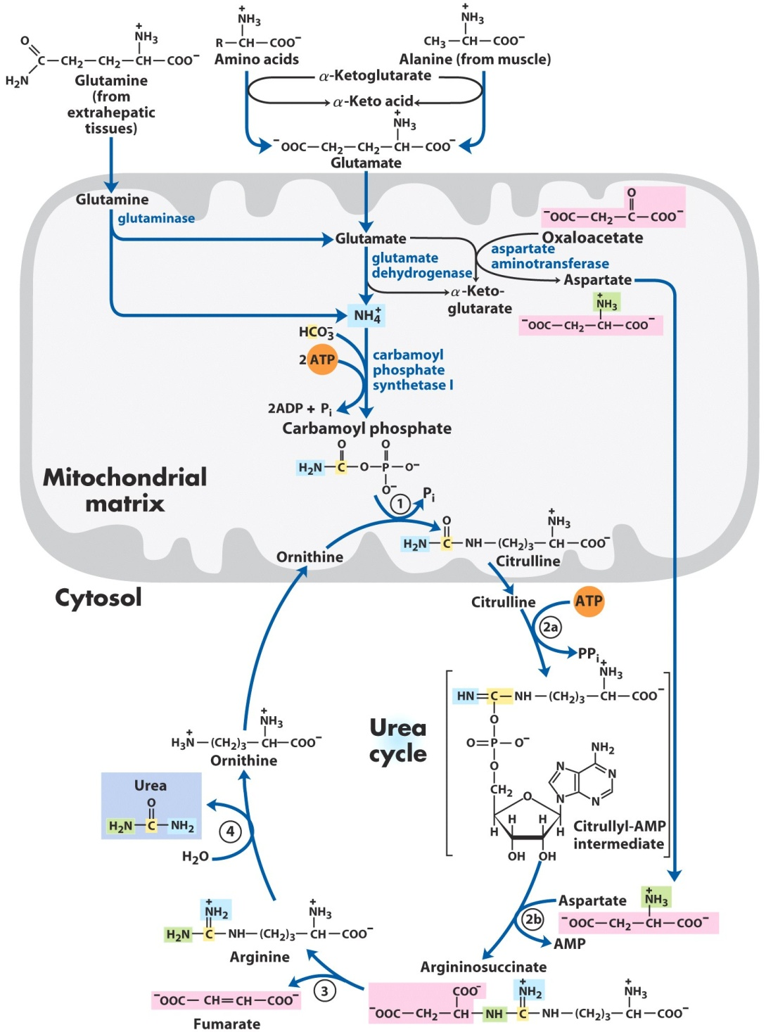
ornithine transcarbamoylase
argininosuccinate synthetase
argininosuccinate lyase
arginase
Urea cycle and reactions that feed amino groups into the cycle

Slide 33
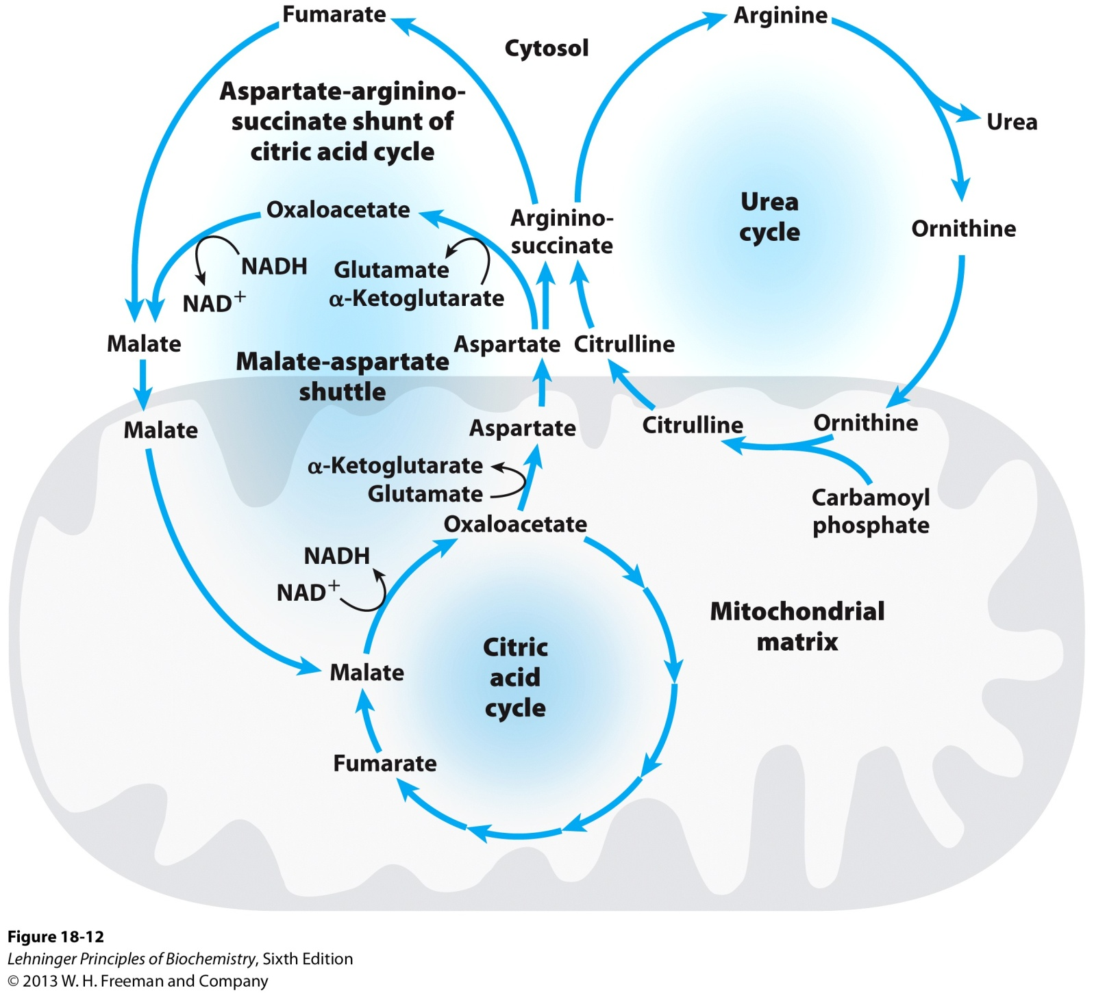
Links between the urea cycle and citric acid cycle

Slide 34
The rate of urea synthesis is controlled at two levels
Allosteric regulation of enzyme activity (fast):
N-acetylglutamate, synthesized from acetyl-CoA and glutamate by the catalysis of N-acetylglutamate synthase, positively regulates carbamoyl phosphate synthetase I activity.
Gene regulation of enzyme amount (slow): syntheses of the five liver enzymes involved in urea synthesis are increased during starvation (when energy has to be obtained from muscle proteins!) or after high protein uptake.

Slide 35
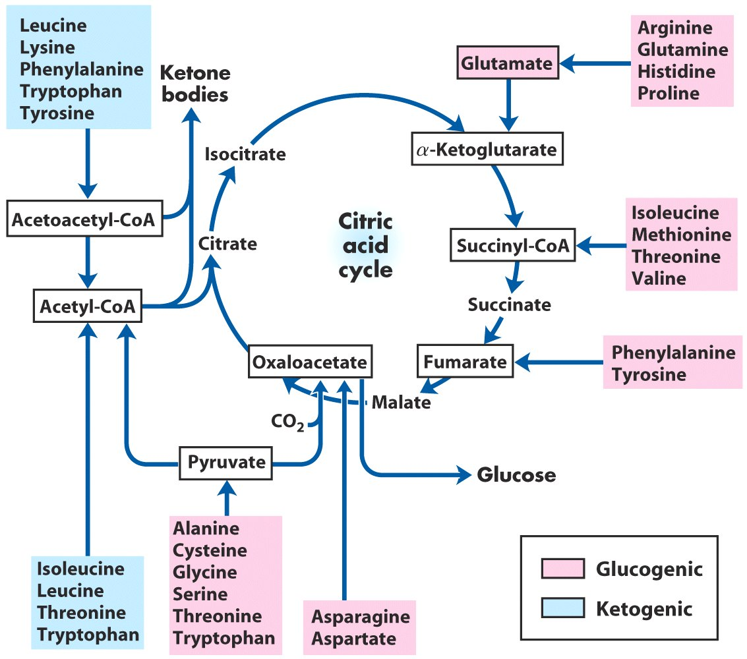
The carbon skeletons of amino acids are oxidized via the citric acid cycle*****

Slide 36
Amino acids can be converted to
glucose (glucogenic) or ketone bodies (ketogenic)*****

Slide 37
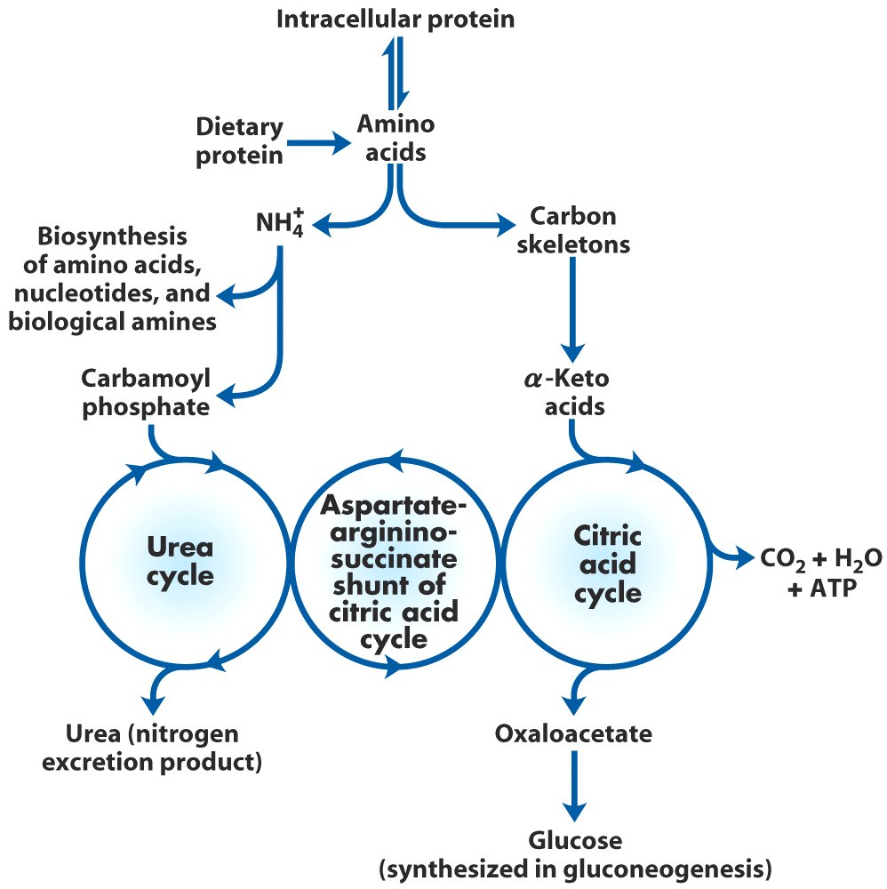
Overview of amino acid catabolism in mammals

Slide 38
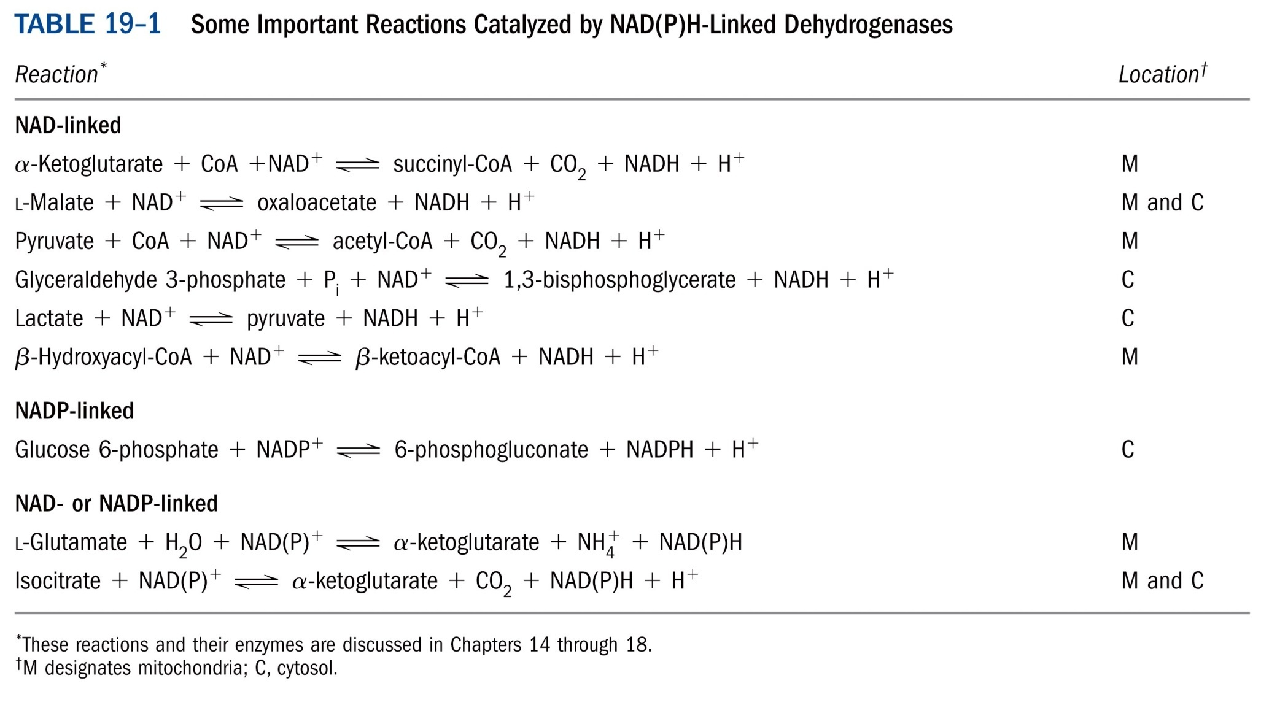
*****

Slide 39
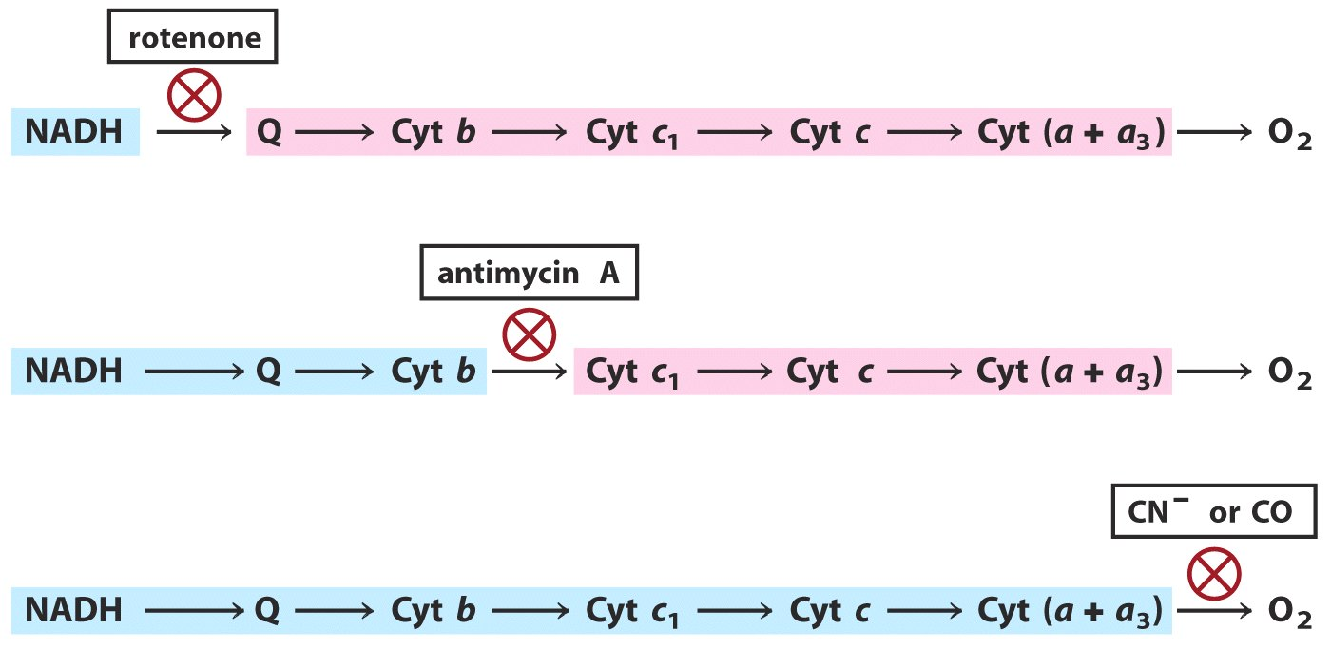
Method 3: Effects of various specific inhibitors those before the blocked step should be reduced and those after should be oxidized.
Reduced
Oxidized
Reduced
Oxidized
Reduced

Slide 40
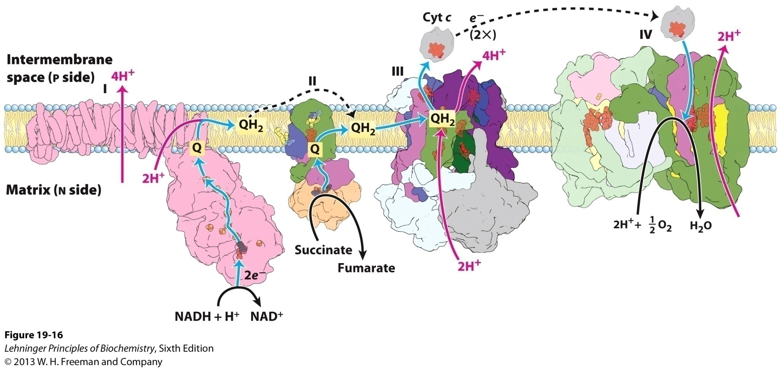
Summary of the flow of electrons and protons
through the four complexes of the respiratory chain*****

Slide 41
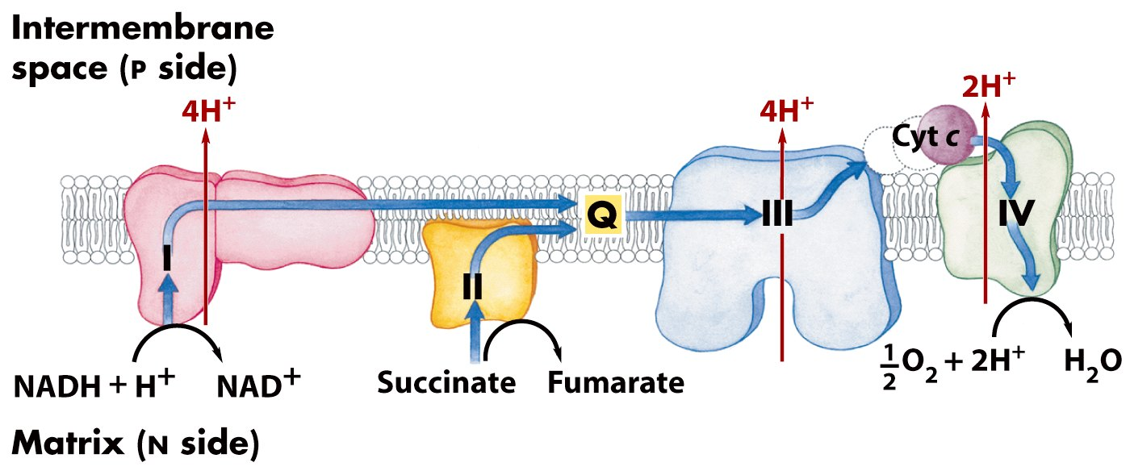
A H⁺ gradient across the inner membrane of
mitochondria (or plasma membrane of bacteria)
is generated by “uphill” H⁺ pumping using energy
released by the “downhill” flow of electrons.

Slide 42
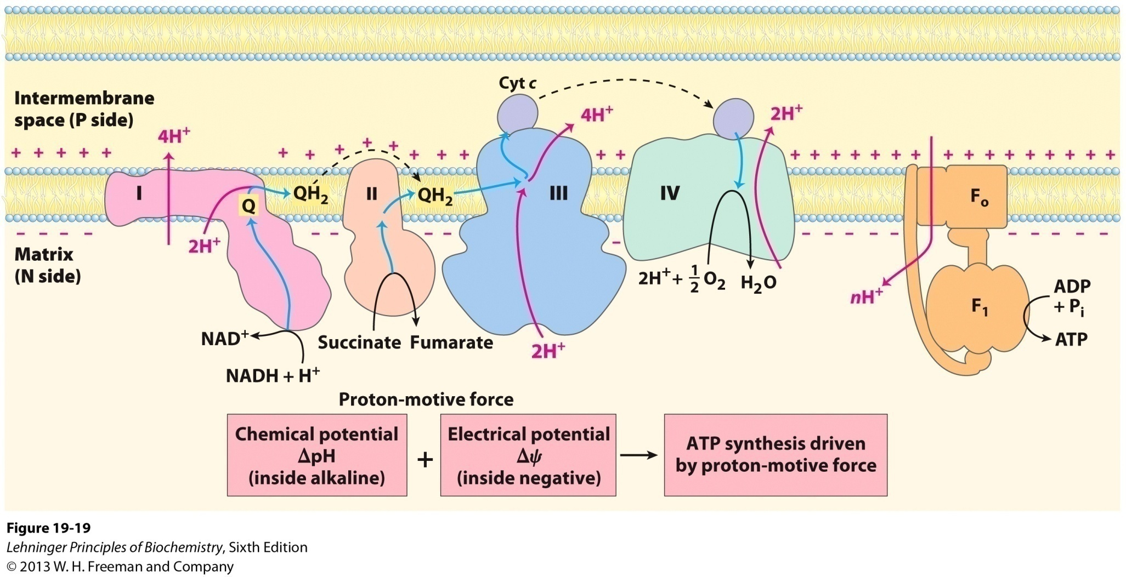
The chemiosmotic model by Mitchell

Slide 43
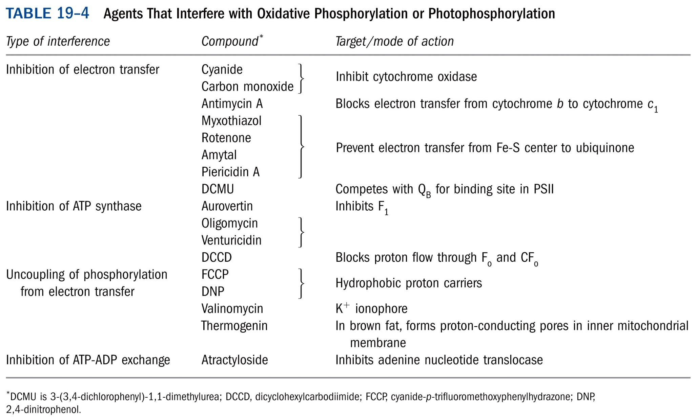
*****

Slide 44
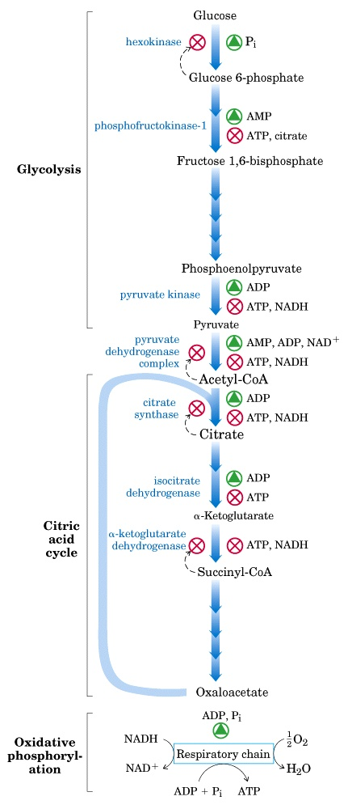
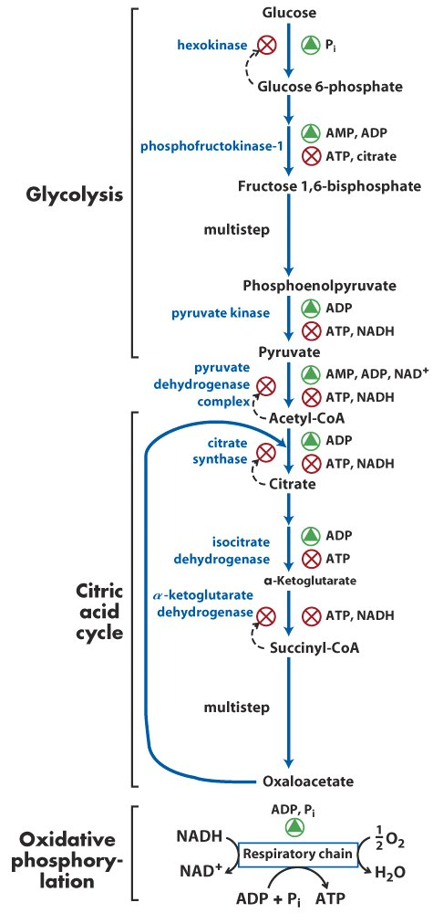
Regulation of the ATP-producing pathways *****

Slide 45
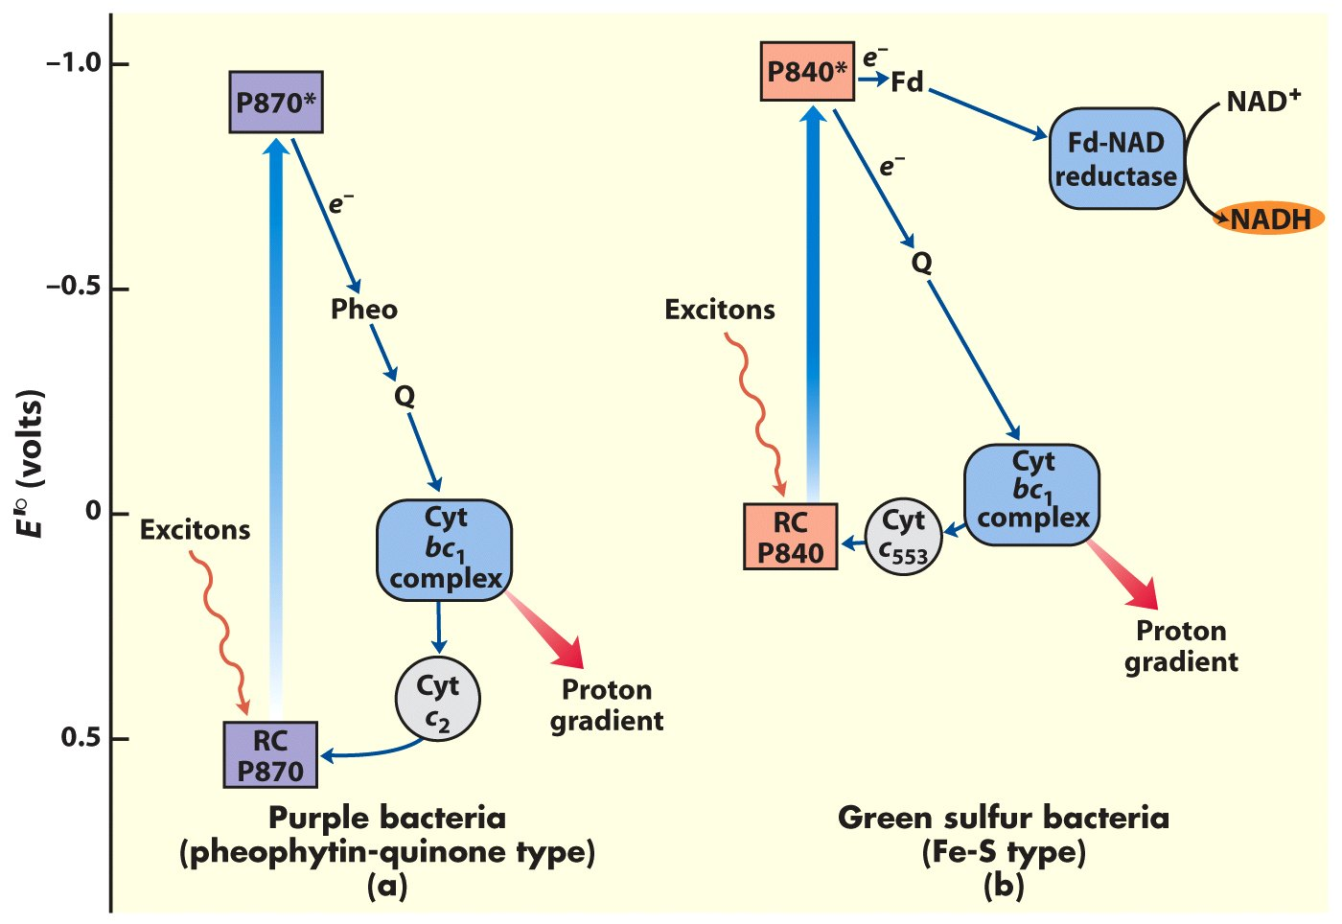
The cyclic and noncyclic electron transfer path
found in photosynthetic bacteria

Slide 46
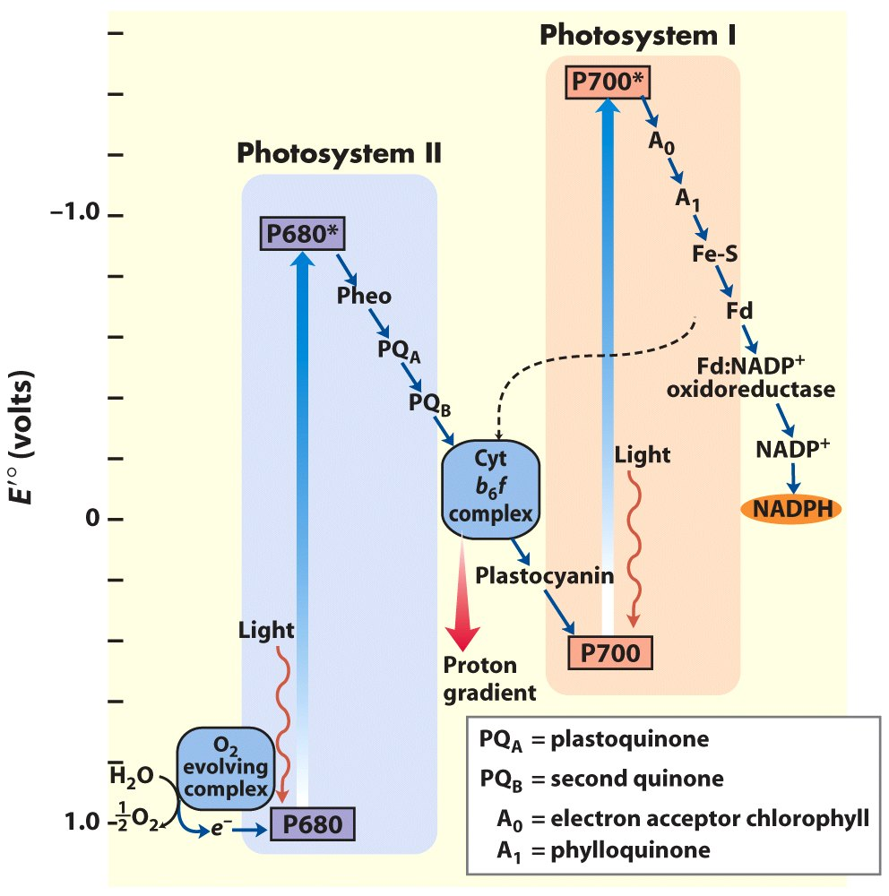
The “ Z scheme”
to show the
electron flow from
PSII to PSI

Slide 47
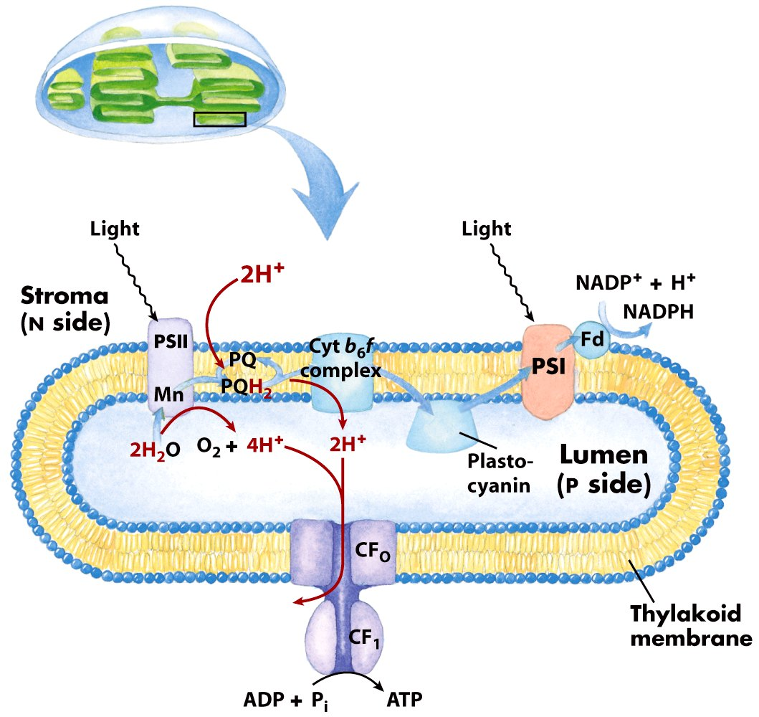
Proton and electron
circuits in thylakoids
2H₂O + 8 photons + 2NADP⁺ + ~3ADP + ~3P_{i}
O₂ + ~3ATP + 2NADPH

Slide 48
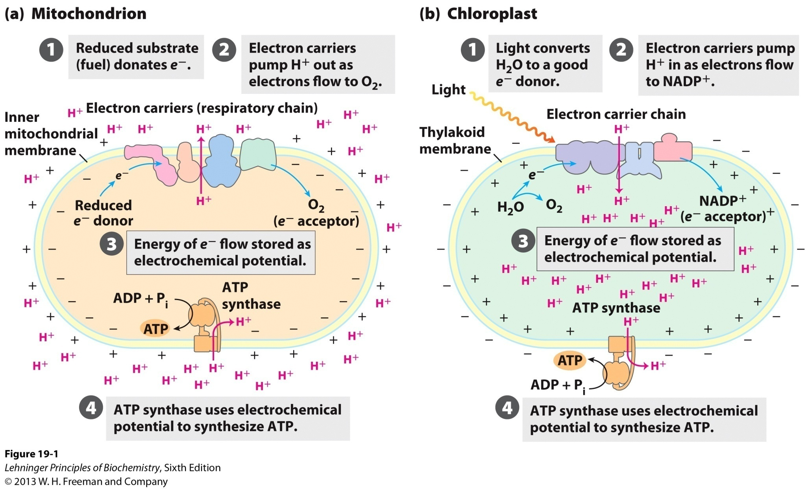
The chemiosmotic mechanism for ATP synthesis

Slide 49
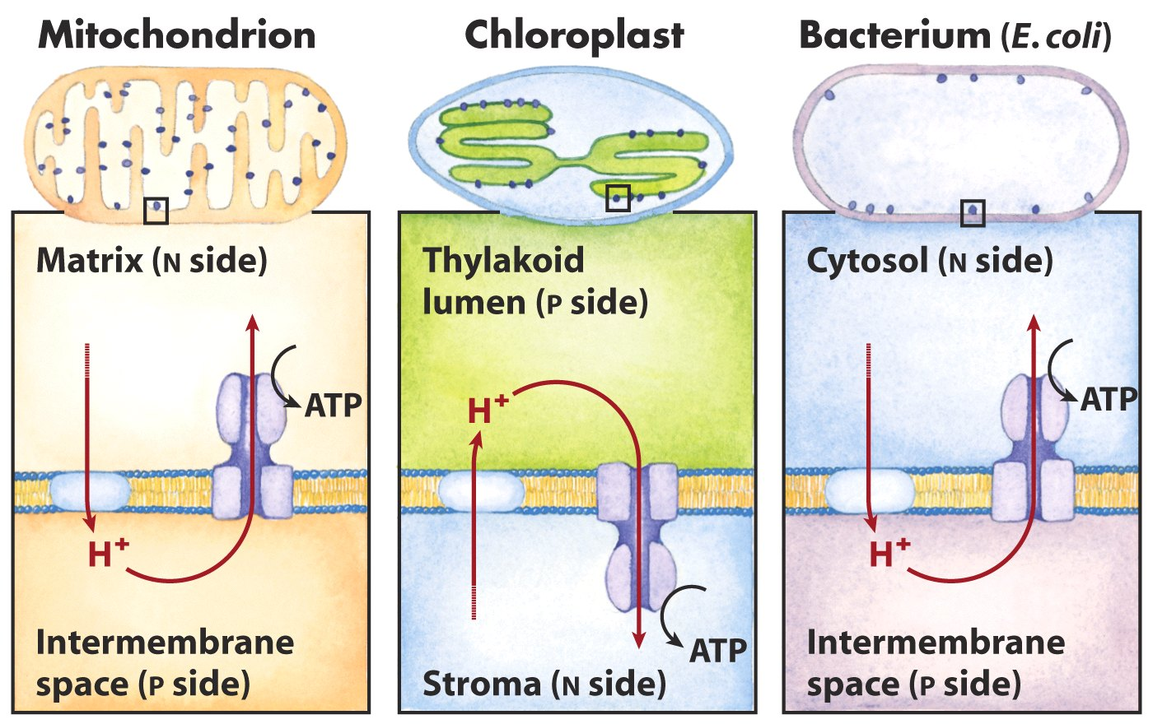
Comparison of the topology of proton movement and
ATP synthase orientation in the membranes of
mitochondria, chloroplasts and bacterium

Slide 50
Oxidative phosphorylation and photophosphorylation are mechanistically similar
1). Both involve the flow of electrons through a chain of membrane-bound carriers.
2). The energy released from “downhill” electron flow is first used for “uphill” pumping of protons to produce a proton gradient (thus a transmembrane electrochemical potential) cross a biomembrane.
3). ATP is then synthesized by a “downhill” transmembrane flow of protons through a specific protein machinery (ATP synthase).

Slide 51
ATP is synthesized using the same strategy in oxidative phosphorylation and photophosphorylation
Oxidative phosphorylation is the process in which ATP is generated as a result of electron flow from NADH or FADH₂ to O₂ via a series of membrane-bound electron carriers called the respiratory chain (reducing O₂ to H₂O at the end)----氧化磷酸化
Photophosphorylation is the process in which ATP (and NADPH) is synthesized as a result of electron flow from H₂O to NADP⁺ via a series of membrane-bound electron carriers (oxidizing H₂O to O₂ at the beginning)----光合磷酸化

Slide 52
Differences between oxidative phosphorylation and photophosphorylation
1). The organelle in which the process occurs: mitochondrion vs. chloroplast
2). The initial source of electrons:
NADH or FADH₂ vs. H₂O (or H₂S, or organic hydrogen donors)
3). Source of energy for the electron donors:
fuel molecules vs. photons
4). Final electron acceptor: O₂ vs. NADP⁺

Slide 53
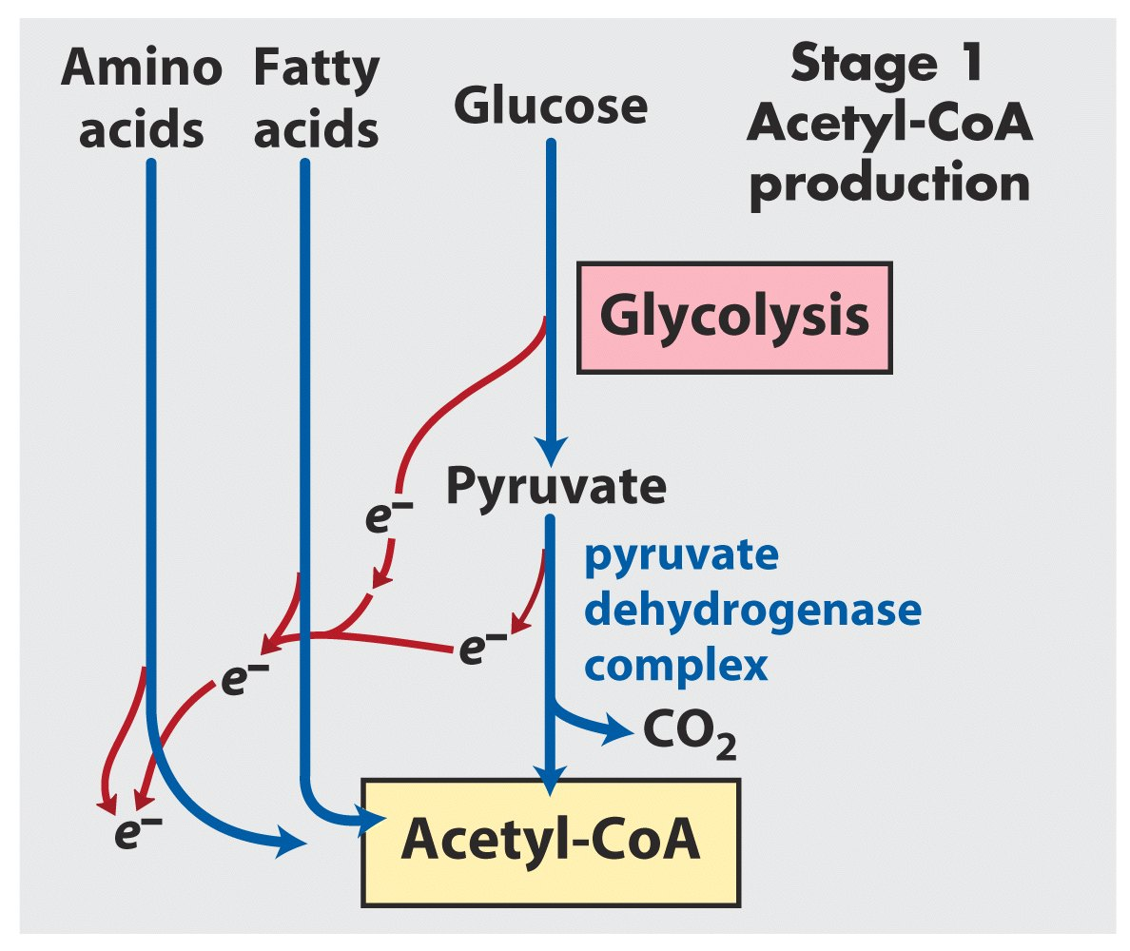

Slide 54
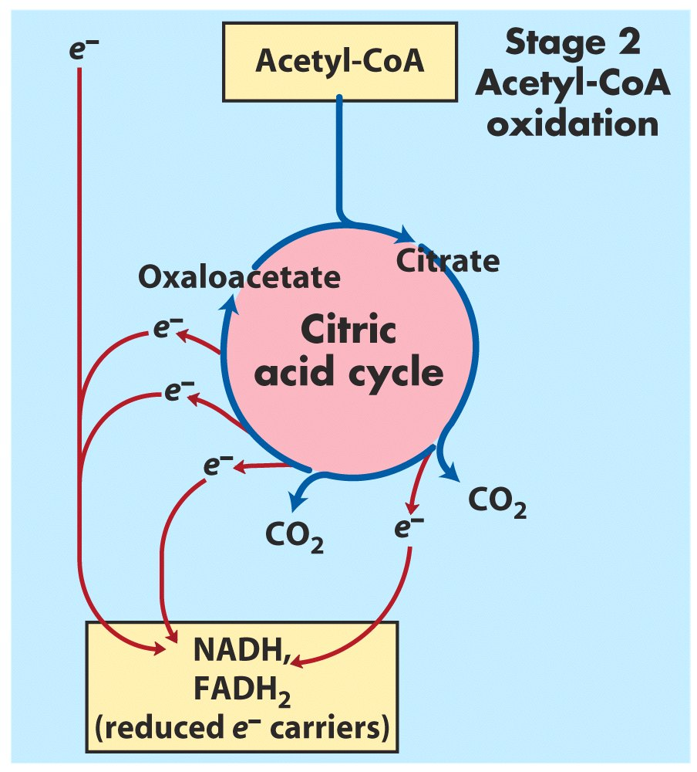

Slide 55
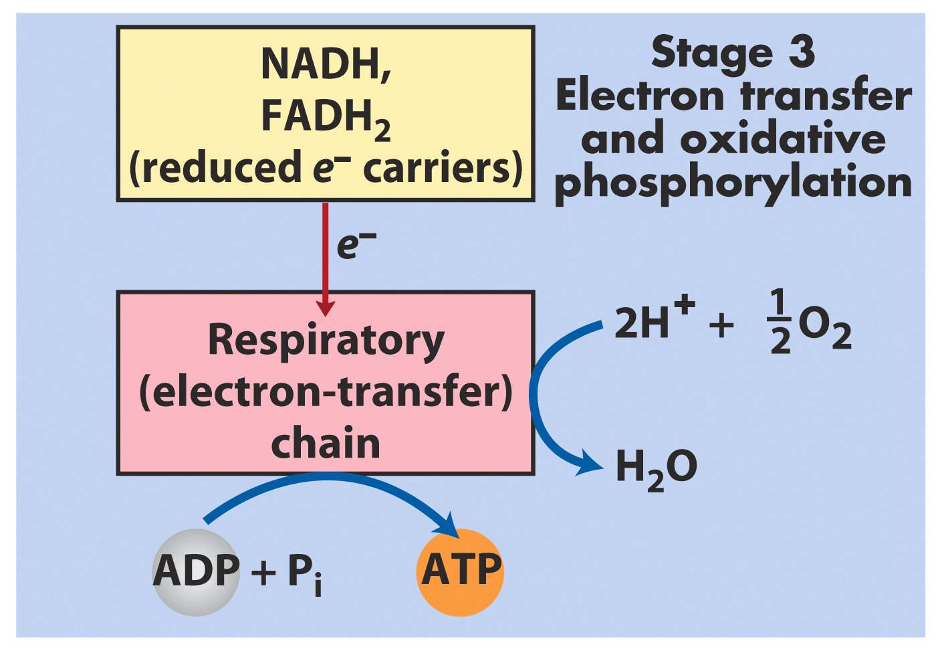

Slide 56
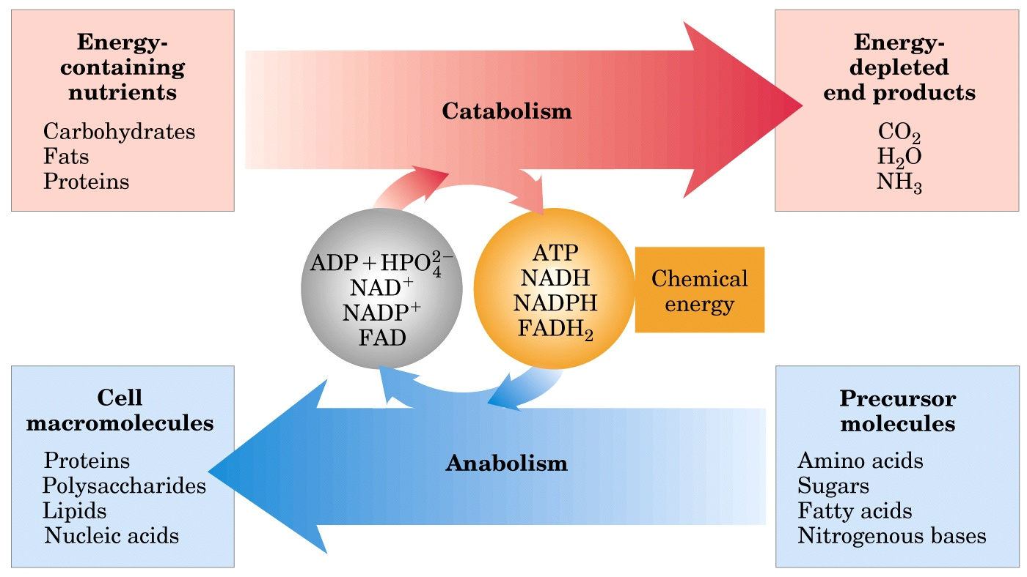
Energy relationships between catabolic and anabolic pathways

